Slide 1
TOUCH 101

Slide 2
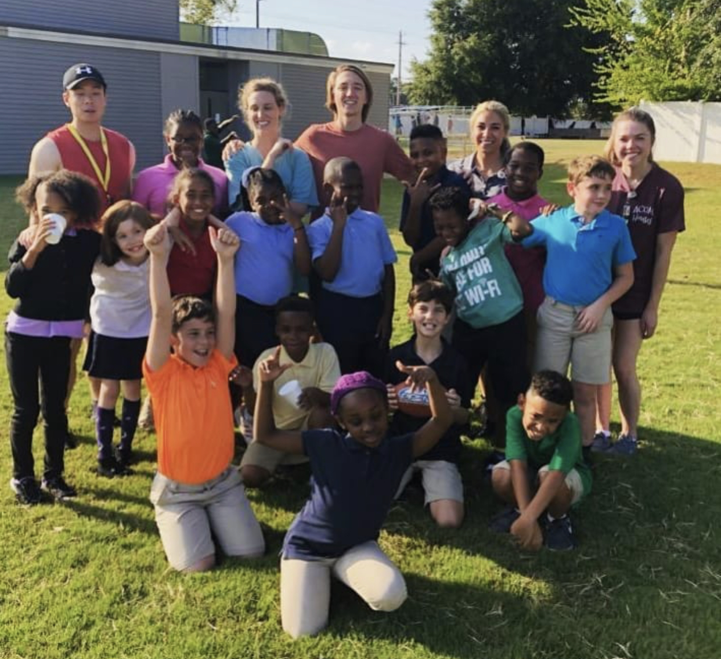
Contact
Jess Harrison: SGA Director of Community Outreach
sgacommunity@acomedu.org
Email me with any questions!
If you know of community/online opportunities that you’d like the school to know about, let me know!

Slide 3
TOUCH
TOUCH
Translating Osteopathic Understanding into Community Health
Goal
Encourage osteopathic medical student involvement into the community to expand understanding of osteopathic values.
Hours
TOUCH vs. Volunteer Hours
TOUCH: activities that improve the health and wellness of a community in order to spread osteopathic tenets.
Volunteer Hours: any activity that does not meet TOUCH standards.

Slide 4
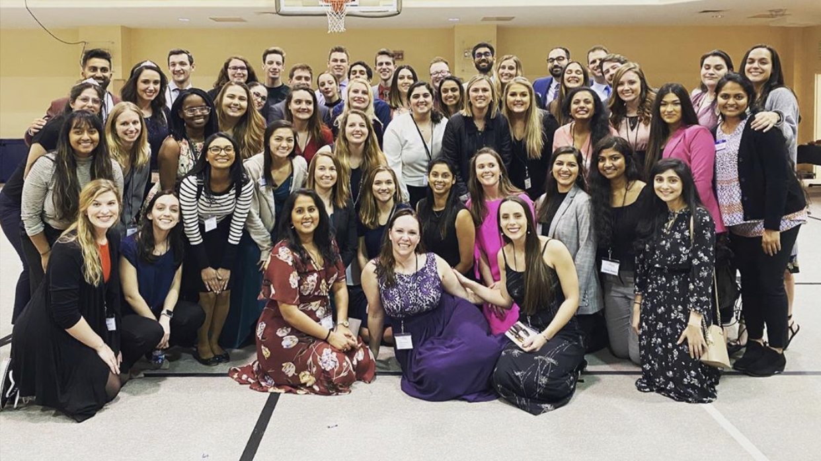
TOUCH CYCLE
1 hour of eligible TOUCH volunteerism = 1 TOUCH point
TOUCH year starts May 1st and ends April 30th of following year

Slide 5
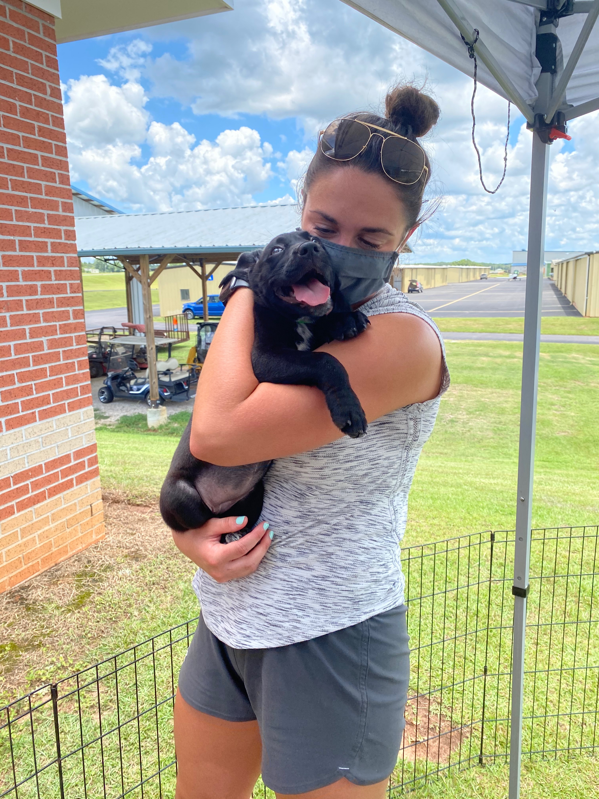
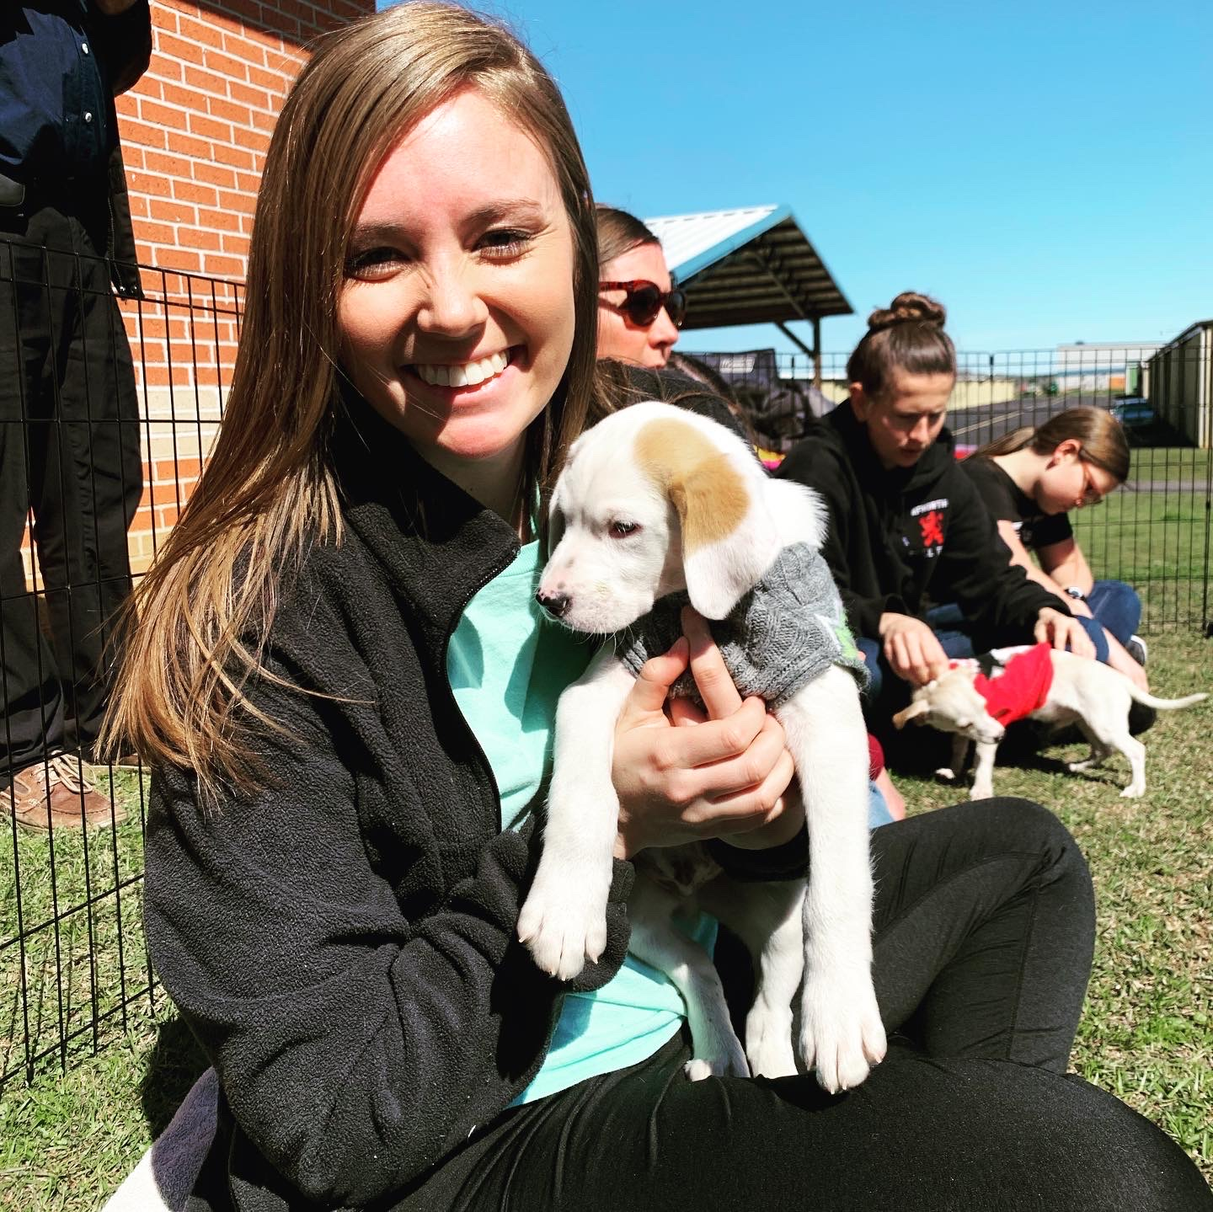
AWARDS
Good way to keep track of your volunteer activities
Graduation TOP 10 TOUCH hours recognized
Local (ACOM) and national recognition (COSGP)
Participation recognition
Students who complete 0.5 to 49.75 approved TOUCH Hours
Silver-level recognition
Students who complete 50 to 99.75 approved TOUCH Hours
Gold-level recognition
Students who complete 100 or more approved TOUCH Hours
Platinum-level recognition
Awarded to the student at each COM with the highest number of approved TOUCH Hours

Slide 6
AWARDS (COVID19 Award Amendments)
Participation recognition
Students who complete 0.5 to 34.75 approved TOUCH Hours
Silver-level recognition
Students who complete 35 to 69.75 approved TOUCH Hours
Gold-level recognition
Students who complete 70 or more approved TOUCH Hours
Platinum-level recognition
Awarded to the student at each COM with the highest number of approved TOUCH Hours

Slide 7
Where do I Sign Up for Events/Volunteering?
On organizations TEAMs page or SignUp.com
https://signup.com/go/AnJoSCp

Slide 8
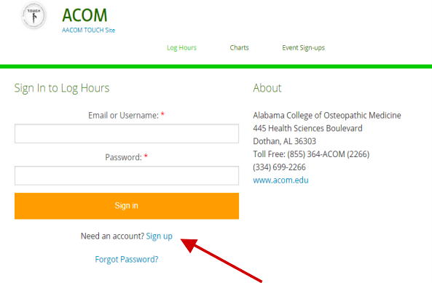
Logging Hours
trackitforward.com/site/acom
Click “Sign Up” and use your ACOM email.

Slide 9
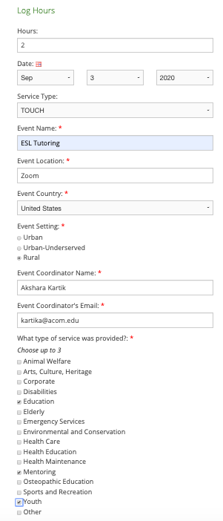
Logging Hours: Submitting an Entry

Slide 10
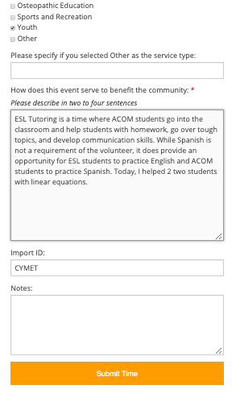
Logging Hours: Event Description
Event Descriptions need 2 things:
1. How your event/activity helped the community and meets TOUCH requirements.
2. How you assisted with the event.
What you shouldn’t write:
I helped with ESL tutoring.

Slide 11
Logging Hours: House Points
In the IMPORT ID section:
Write in your name for HOUSE points.
If left blank, they will not count towards your HOUSE points.

Slide 12
TOUCH Eligibility
Awareness Events (DO day on the Hill, ShaDO Day)
Events where you reach out to the community
Events where you work with community members
Volunteering at the humane society
Medical trips
Mission trips
Volunteering at camps
Blood donation = 0.5 TOUCH point
Plasma donation = 1 TOUCH point
By ACOM for ACOM
Conferences
Training
Shadowing
Any events where you receive compensation
Ride Along with an EMS
Hours completed prior to matriculation
On call hours (crisis hotline or EMS)
Supplies drives (unless packing and delivering)
Research
Running/walking in a charity event

Slide 13
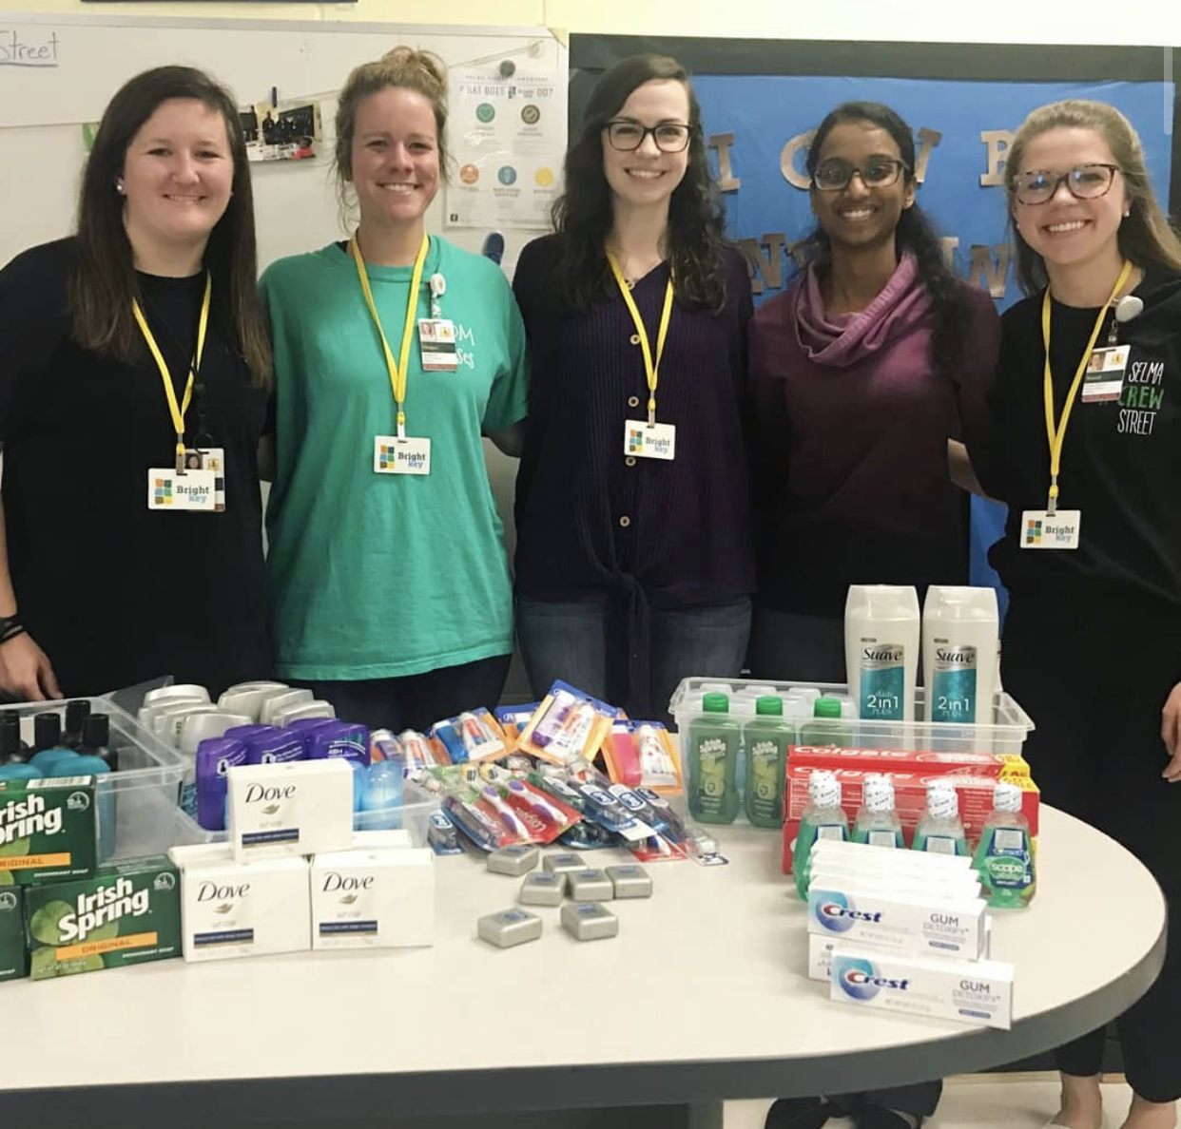
Planning Hours
If you are involved with the planning committee of a community event that is eligible for TOUCH, you may submit planning hours
1 hour of planning = 0.5 TOUCH points
You can earn up to 15 planning hours per TOUCH year!
In the description box, include the amount of hours planned.

Slide 14
Volunteer Trips
Log each day you’re volunteering as it’s own entry!
There are not more than 24 hours in 1 day
Cannot have an entry with more than 20 hours each day
Please be truthful about hours
If you were on a mission trip did you actually volunteer 20 hours a day for a week or did you volunteer 8 hours a day?
Can have the same description if you are doing the same work

Slide 15
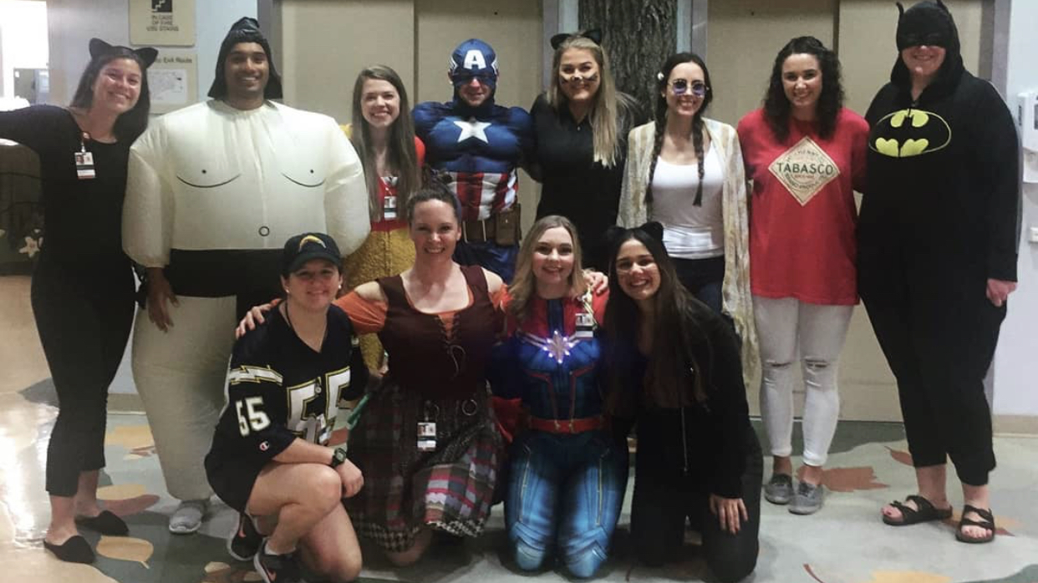
Submissions
RULES:
Must submit within 30 days of the event
If event lasts over 10 hours, must get written proof
AFTER:
Hours are approved by the SGA Director of Community Outreach
If denied, they will be counted as volunteer hours.
Please keep record of your hours, as further proof may be requested.
DISPUTES:
Any discrepancies will be under review by the COSGP National TOUCH Coordinator.

Slide 16
Falsifying Events
First offense:
The submission will be stricken from the record.
Student will receive a warning and administration with be notified
Second offense:
The student will receive no credit for previous hours.
Student will be deemed ineligible for TOUCH recognition the remainder of the TOUCH year.

Slide 17
No Shows
If the volunteer’s schedule changes within 7 days of an event, the individual is responsible for immediately informing and working with the SGA Director of Community Outreach (or organization contact) to find a replacement. Failure to inform the appropriate people will be treated as a No Show
If the volunteer cancels within 48 hours of the event without contacting the event organizer and finding a replacement, this will be considered a No Show
If the volunteer is absent because of an unforeseen life event (family emergency, illness, death, etc) the No Show policy will be evaluated on a case by case basis and proof will be required.
First Offense:
- Written warning from SGA Director of Community Outreach
- Audrey Bawcum informed
Second Offense:
- Individual will be unable to claim their next 5 TOUCH point hours
Third Offense:
- Meeting with Dr. Reynolds regarding unprofessional behavior

Slide 18
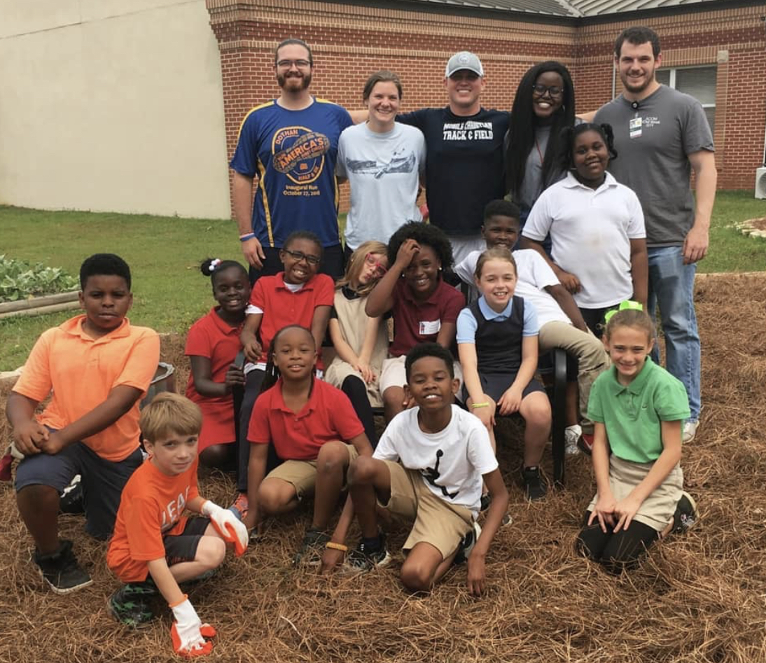
Quick ACOM References
https://www.acom.edu/touch-program/
TOUCH Standards
https://www.aacom.org/become-a-doctor/resources-for-medical-students/cosgp/touch-program

Slide 19
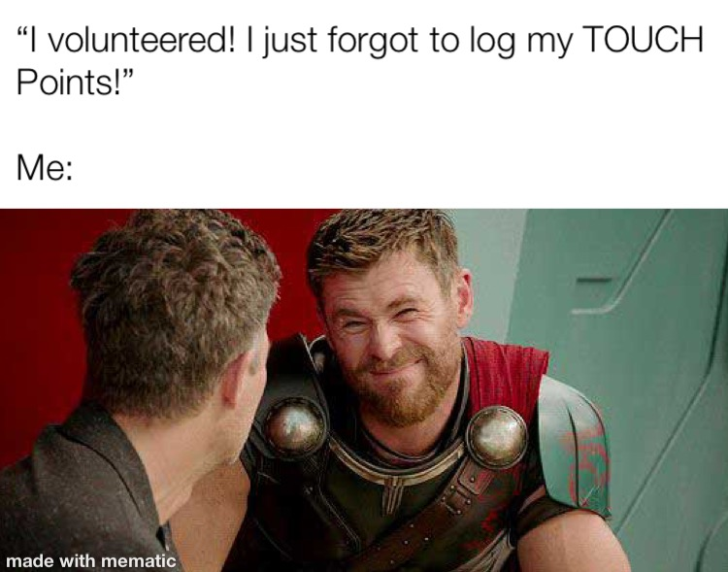
Any Questions?

